Slide 1
A Scalable, Commodity Data Center Architecture

Slide 2
Overview
Structure and Properties of a Data Center
Desired properties in a DC Architecture
Fat tree based solution
Monsoon: layer 2 flat routing

Slide 3
Anatomy of a Datacenter
Servers (Physical machines)
Storage
Network devices (switch, router, cables)
Power distribution systems
Cooling systems
…

Slide 4
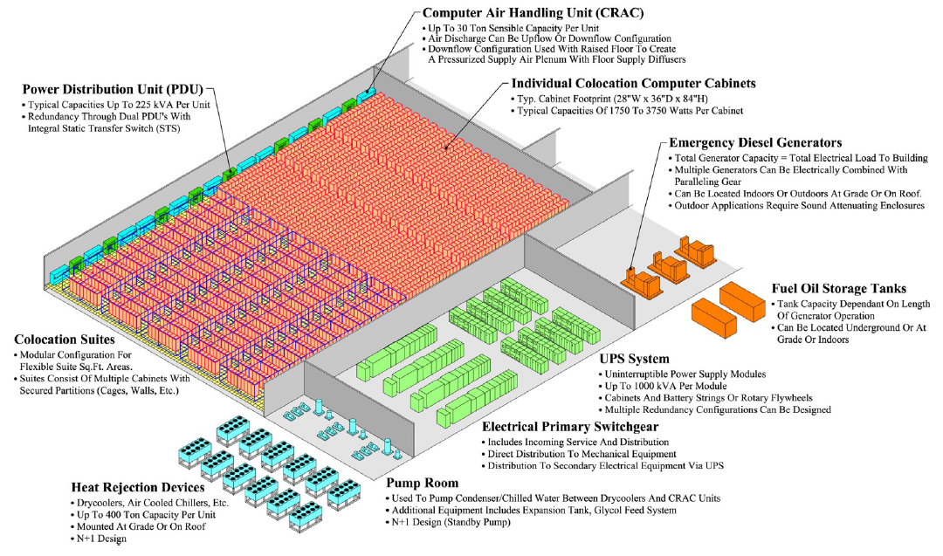
Anatomy of a Datacenter
Source: Barroso and Urs Hölzle (2009)

Slide 5
Electrical Power-1
Condition circuits
  Little power fluctuations
UPS
  On Line
    Power is conditioned by the unit
    Equipment draws power from UPS all the time
  Off Line
    Equipment draws power from the UPS only when external source of electricity has been lost
UPS have short power cycle
  Back up with Generators
Automatic Transfer Switch – ATS
Compute the Electrical Load
  All Components, UPS charging

Slide 6
Electrical Power-2
Overhead power distribution
Racks with Power Distribution Units (PDU)
  Keep it all within the rack
Multiple power sources (circuits)

Slide 7
A DC-wide System
Has software systems consisting of:
  Distributed system, logical clocks, coordination and locks, remote procedural call…etc
  Distributed file system
  (We do not go deeper into above components)
  Parallel computation: MapReduce, Hadoop
Virtualized Infrastructure:
  Computing: Virtual Machine / Hypervisor
  Storage: Virtualized / distributed storage
  Network: Network virtualization

Slide 8
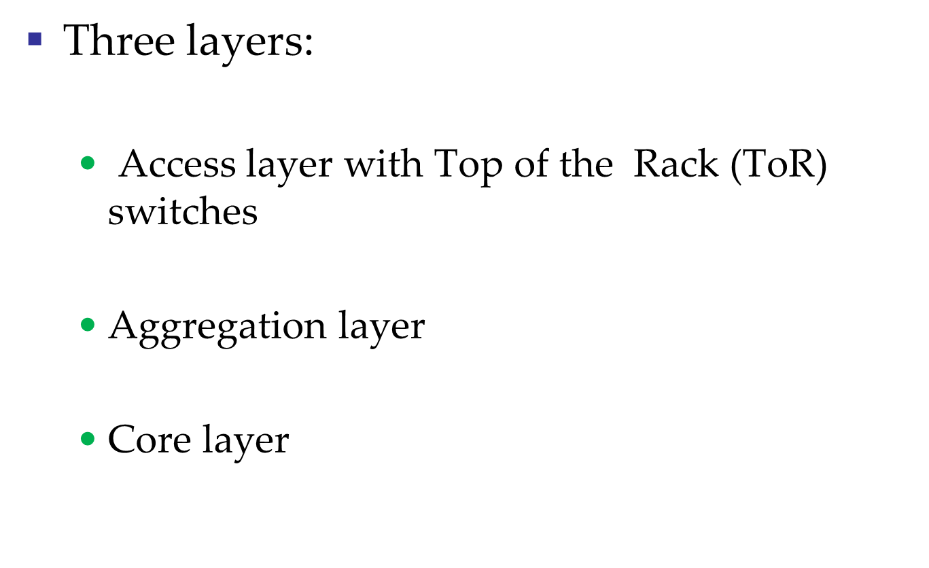
Conventional Topology

Slide 9
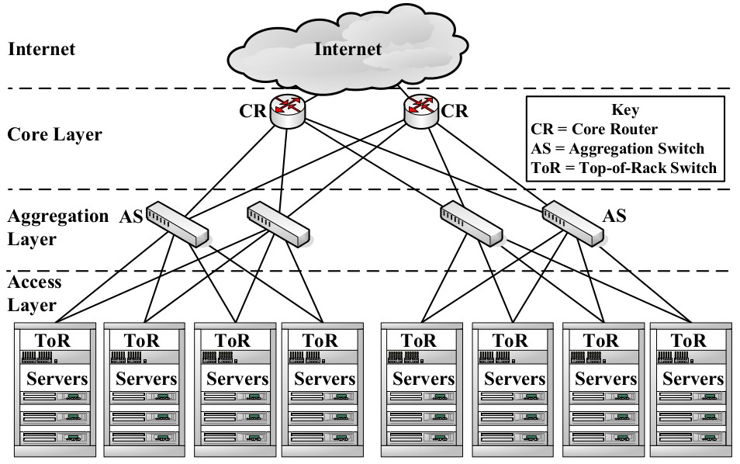
Common data center topology
Data Center
Notes:
Before describing the problems with current middlebox deployment approaches, let me first describe the commonly used 3-tier data center network topology. At the top is the core-tier, whose layer-3 routers connect the data center to the Internet or to the rest of the campus network. At the bottom is the access tier, containing the layer-2 switches into which servers are plugged in.
In between the access and core tiers are the layer 2/3 switches of the aggregation tier. Middleboxes are commonly deployed at the aggregation tier.
Multiple redundant links connect together the various switches and servers. To prevent forwarding loops, we use mechanisms like spanning tree construction to block out some of the links. For example, the topology as shown here.

Slide 10
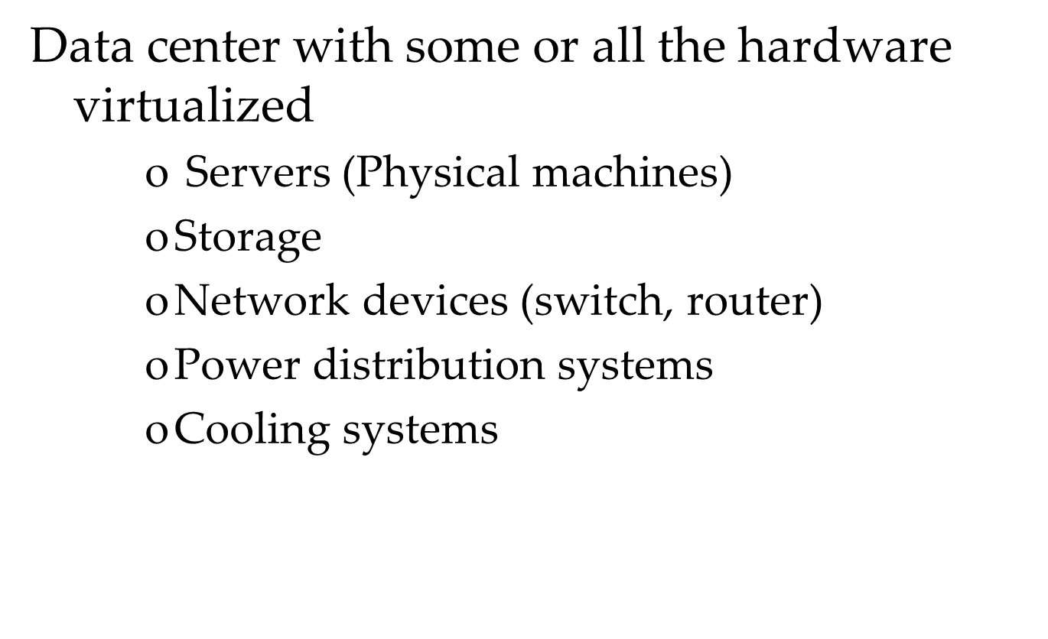
Virtualized Data Center

Slide 11
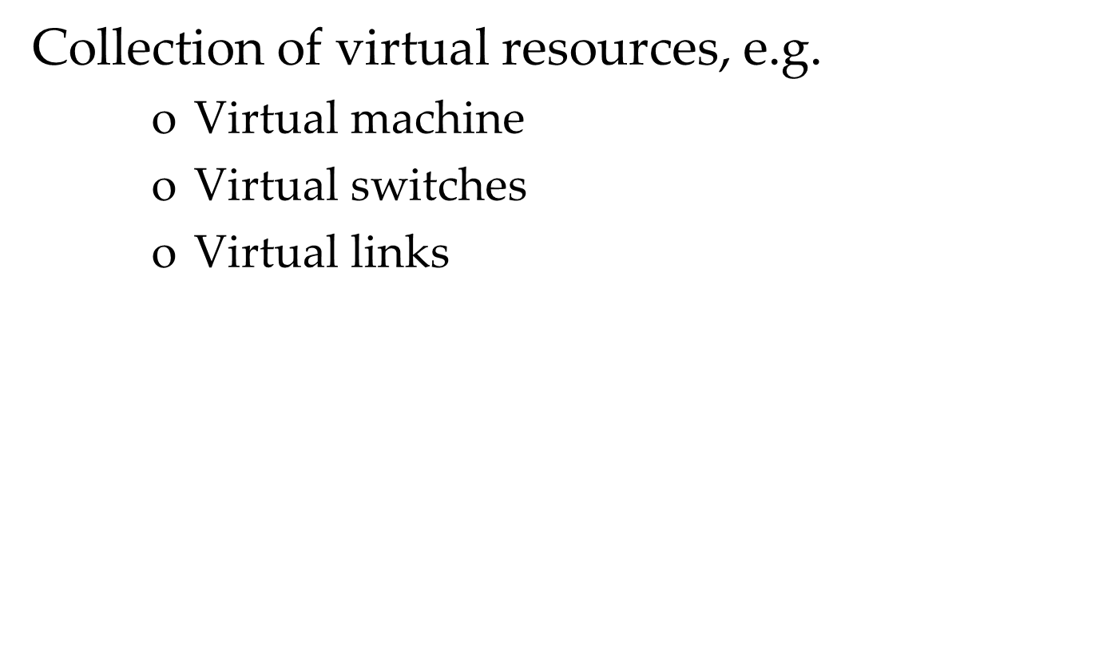
Virtual Data Center

Slide 12
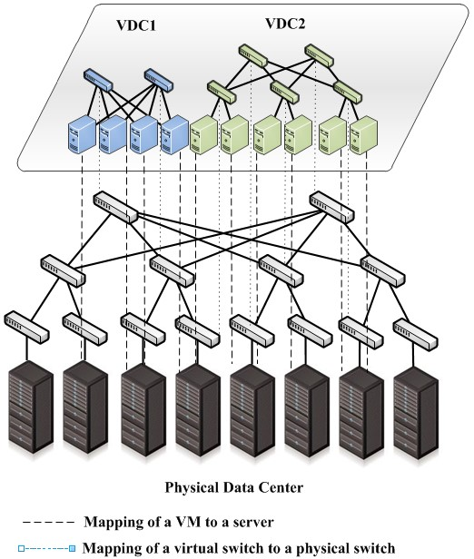

Virtual Data Center

Slide 13
Problem With common DC topology
Single point of failure
Over subscript of links higher up in the topology
  Trade off between cost and provisioning

Slide 14
Properties of solutions
Backwards compatible with existing infrastructure
  No changes in application
  Support of layer 2 (Ethernet)
Cost effective
  Low power consumption & heat emission
  Cheap infrastructure
Allows host communication at line speed

Slide 15
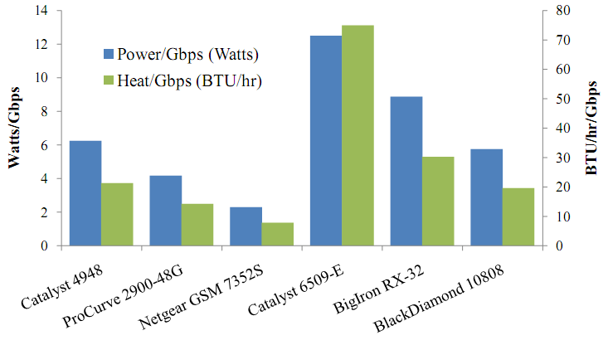
Cost of maintaining switches
Notes:
Netgear ~ 3K
Procurve – 4.5K

Slide 16
Need for Layer 2 In DC
Certain monitoring apps require server with same role to be on the same vlan
Using same ip on dual homed servers
Allowing growth of server farms.

Slide 17
Review of Layer 2 & Layer 3
Layer 2
  One spanning tree for entire network
    Prevents looping
    Ignores alternate paths
Layer 3
  Shortest path routing between source and destination
  Best-effort delivery
Notes:
In this talk, I shall next explain the problems with current middlebox deployment mechanisms.
I shall then describe how our solution, the policy-aware switching layer simplifies middlebox deployment and achieves the properties I mentioned earlier.
I shall briefly discuss related work, and our prototype implementation and evaluation of the policy-aware switching layer.

Slide 18
FAT Tree based Solution
Connect end-host together using a fat tree topology
  Infrastructure consist of cheap devices
    Each port supports same speed as endhost
  All devices can transmit at line speed if packets are distributed along existing paths
  A k-port fat tree can support k3/4 hosts

Slide 19
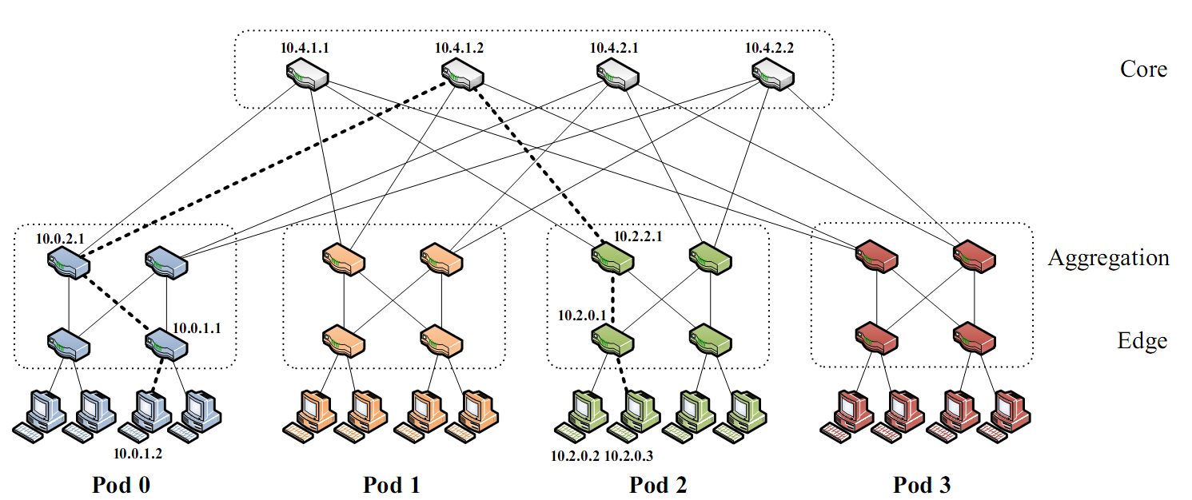
Fat-Tree Topology

Slide 20
Problems with a vanilla Fat-tree
Layer 3 will only use one of the existing equal cost paths
Packet re-ordering occurs if layer 3 blindly takes advantage of path diversity

Slide 21
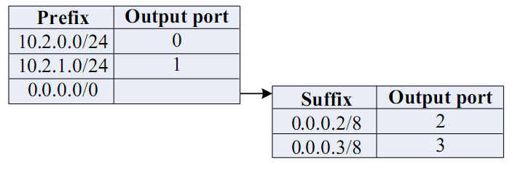
FAT-tree Modified
Enforce special addressing scheme in DC
  Allows host attached to same switch to route only through switch
  Allows inter-pod traffic to stay within pod
  unused.PodNumber.switchnumber.Endhost
Use two level look-ups to distribute traffic and maintain packet ordering.

Slide 22
2 Level look-ups
First level is prefix lookup
  Used to route down the topology to endhost
Second level is a suffix lookup
  Used to route up towards core
  Diffuses and spreads out traffic
  Maintains packet ordering by using the same ports for the same endhost

Slide 23
Diffusion Optimizations
Flow classification
  Eliminates local congestion
  Assign to traffic to ports on a per-flow basis instead of a per-host basis
Flow scheduling
  Eliminates global congestion
  Prevent long lived flows from sharing the same links
  Assign long lived flows to different links

Slide 24
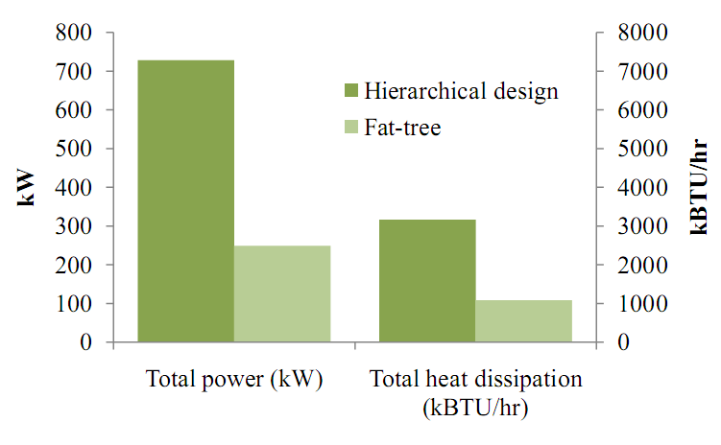
Results: Heat & Power Consumption

Slide 25
Draw Backs
No inherent support for VLan traffic
Data center is fixed in size
Ignored connectivity to the internet
Waste of address space
  Requires NAT at border

Slide 26
Monsoon approach
Layer 2 based using future commodity switches
Hierarchy has 2:
  access switches (top of rack)
  load balancing switches
Eliminate spanning tree
  Flat routing
  Allows network to take advantage of path diversity
Prevent MAC address learning
  4D architecture to distribute data plane information
  TOR: Only need to learn address for the intermediate switches
  Core: learn for TOR switches
Support efficient grouping of hosts (VLAN replacement)

Slide 27
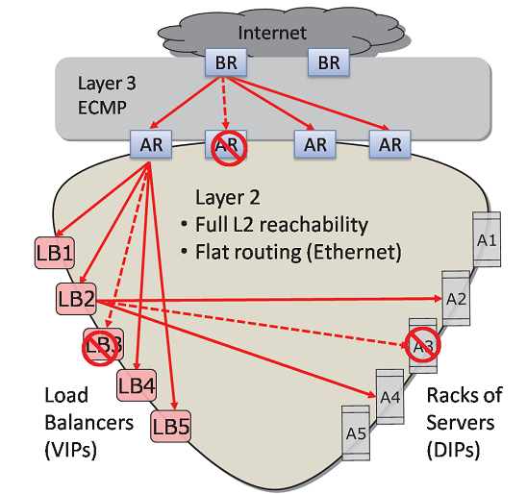
Monsoon

Slide 28
Monsoon Components
Top-of-Rack switch:
  Aggregate traffic from 20 end host in a rack
  Performs ip to mac translation
Intermediate Switch
  Disperses traffic
  Balances traffic among switches
  Used for valiant load balancing
Decision Element
  Places routes in switches
  Maintain a directory services of IP to MAC
Endhost
  Performs ip to mac lookup

Slide 29
How routing works
End-host checks flow cache for MAC of flow
  If not found ask monsoon agent to resolve
  Agent returns list of MACs for server and MACs for intermediate routers
Send traffic to Top of Router
  Traffic is triple encapsulated
Traffic is sent to intermediate destination
Traffic is sent to Top of rack switch of destination
Notes:
Equal-cost multi-path routing (ECMP) is a routing strategy where next-hop packet forwarding to a single destination can occur over multiple "best paths" which tie for top place in routing metric calculations.

